Slide 1
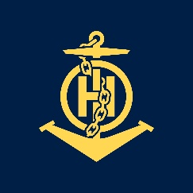
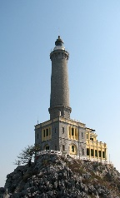
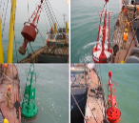
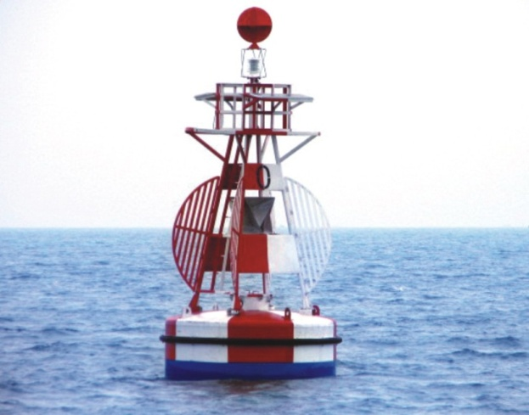
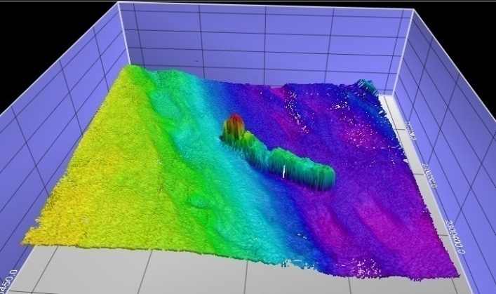
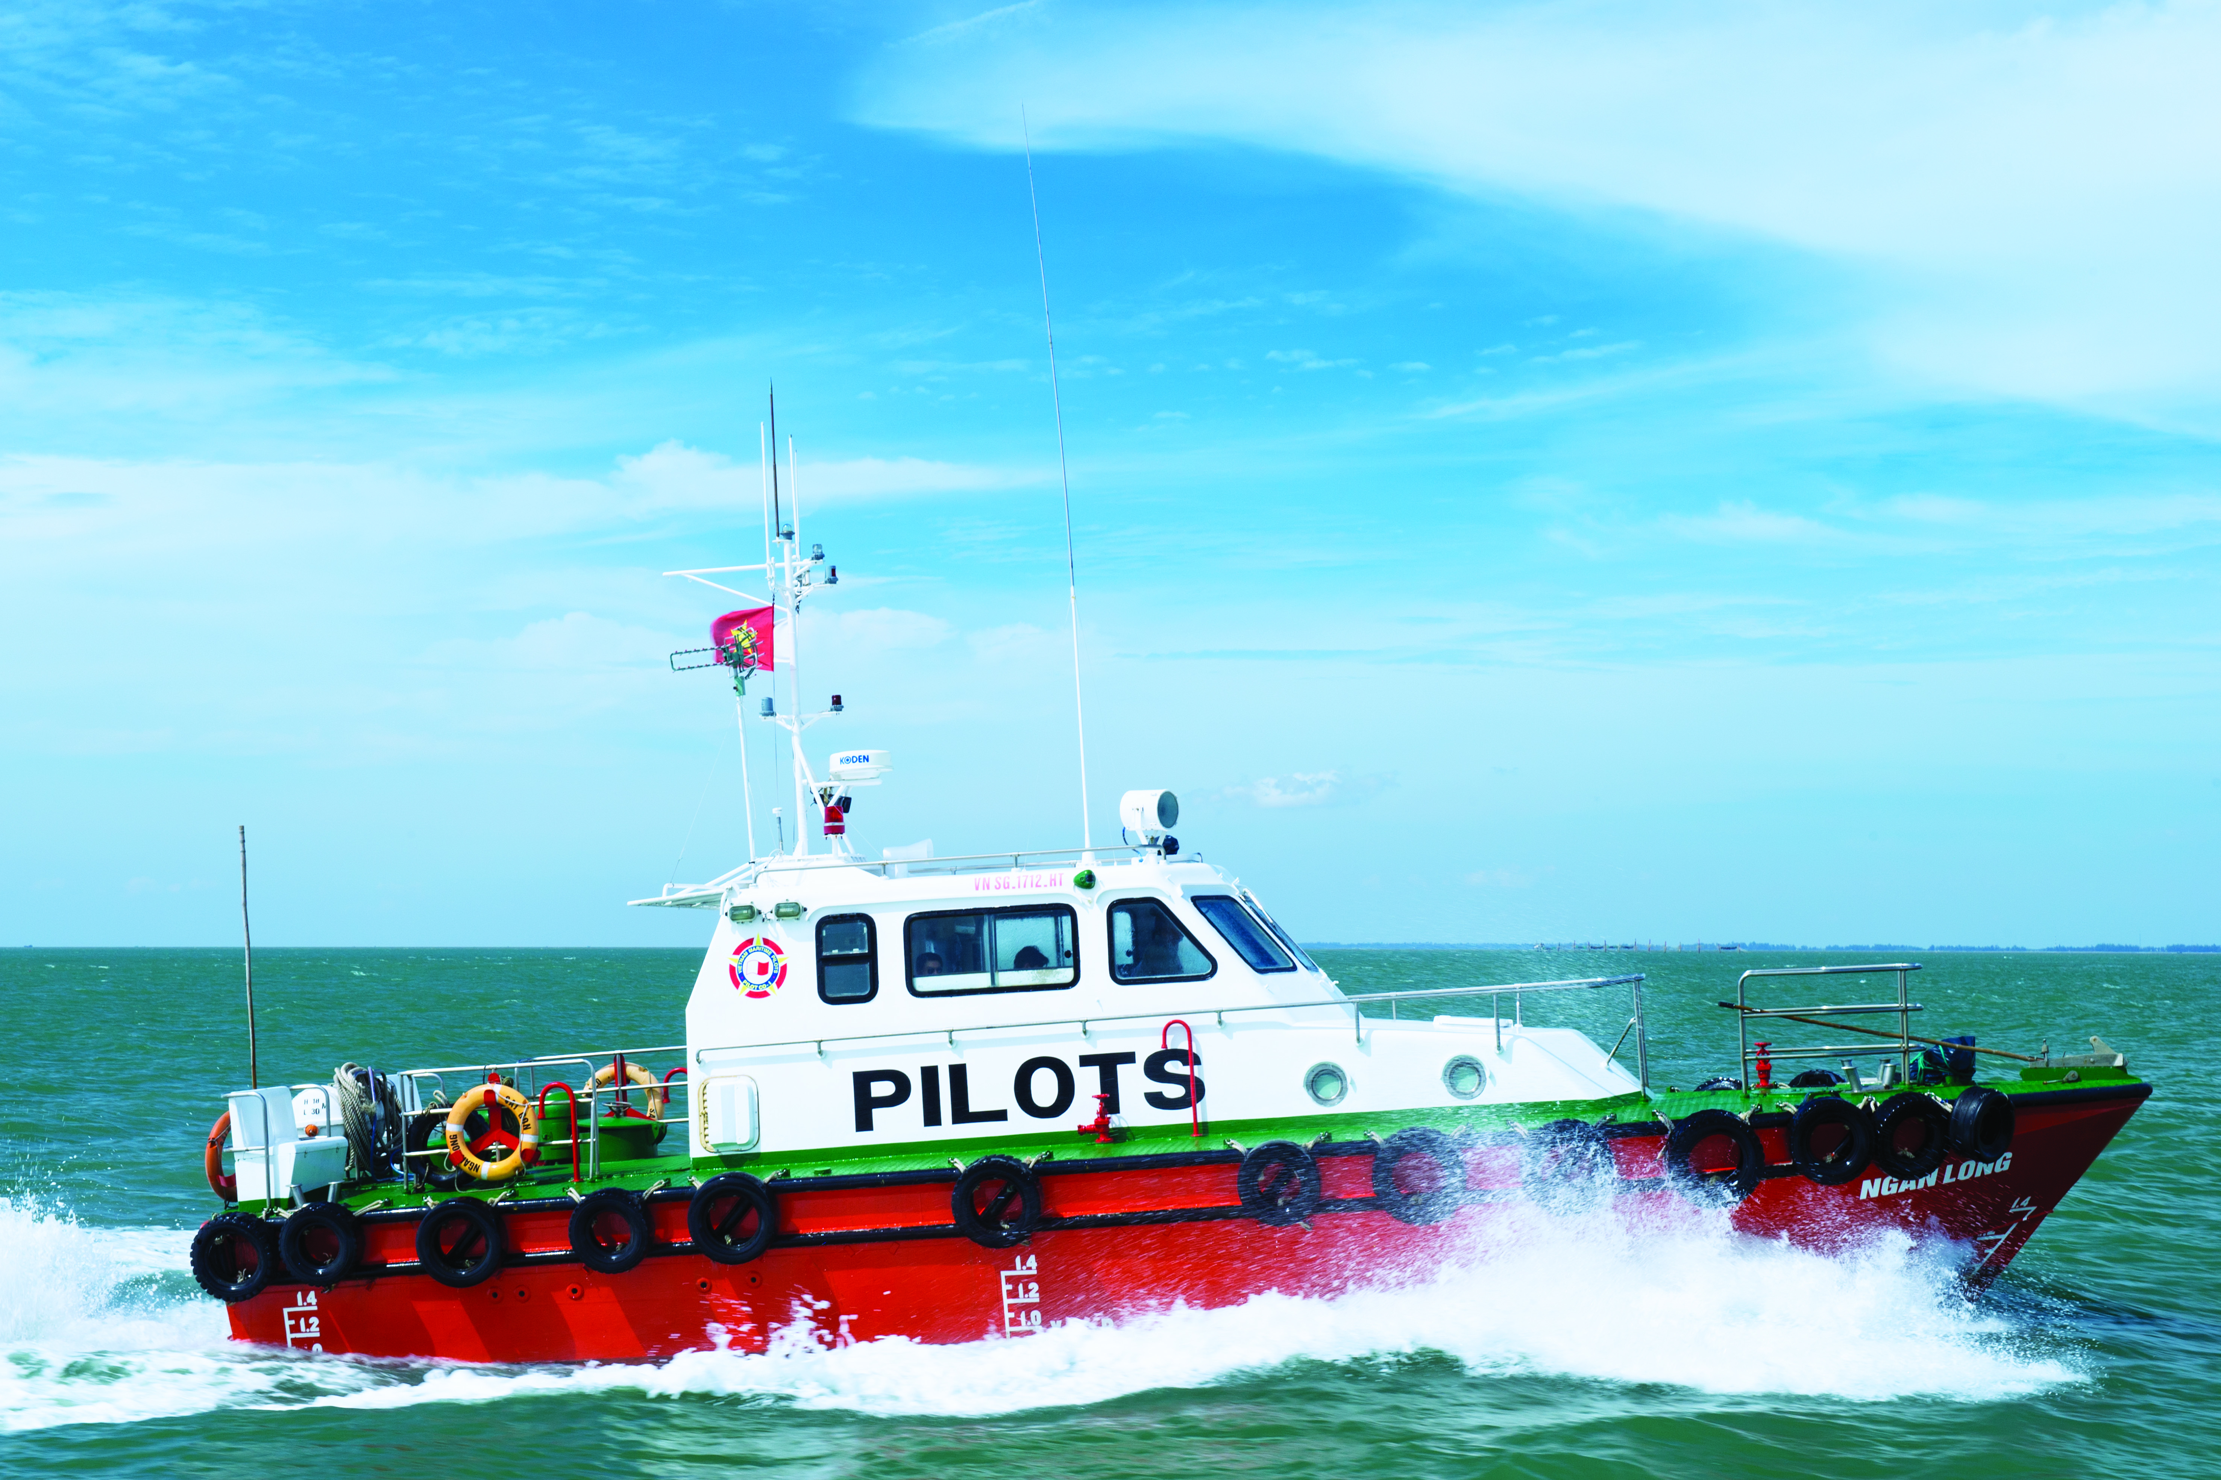
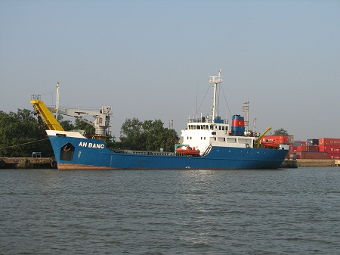
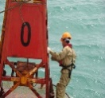
IHO – NIPPON FOUNDATION
ALUMNI SEMINAR
Nguyen Phuc CHINH

Slide 2
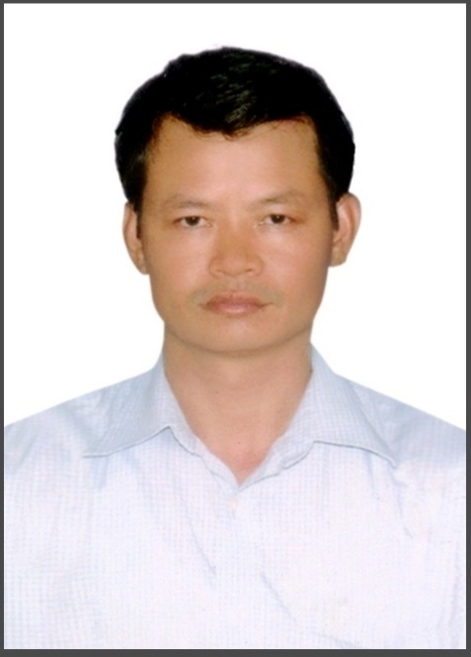
Self introduction
IHO – NIPPON FOUNDATION
ALUMNI SEMINAR
Name | Nguyen Phuc CHINH
Alumni year | 2010
Country | Vietnam
Organization | Vietnam Maritime Safety – North
Position/Job title | Head of Maritime Safety Department
Current job description | Aids to Navigation Hydrographic surveys, Nautical Charts Pilotage service
Please put your photo here!

Slide 3
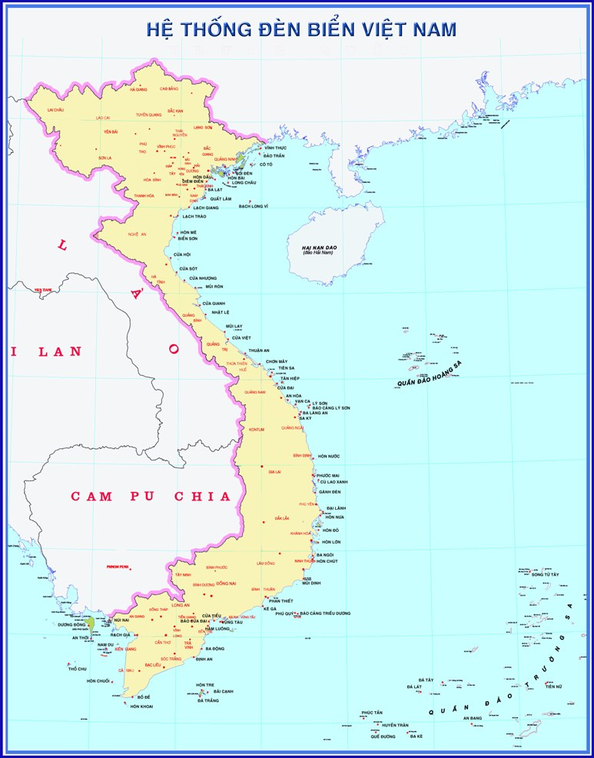
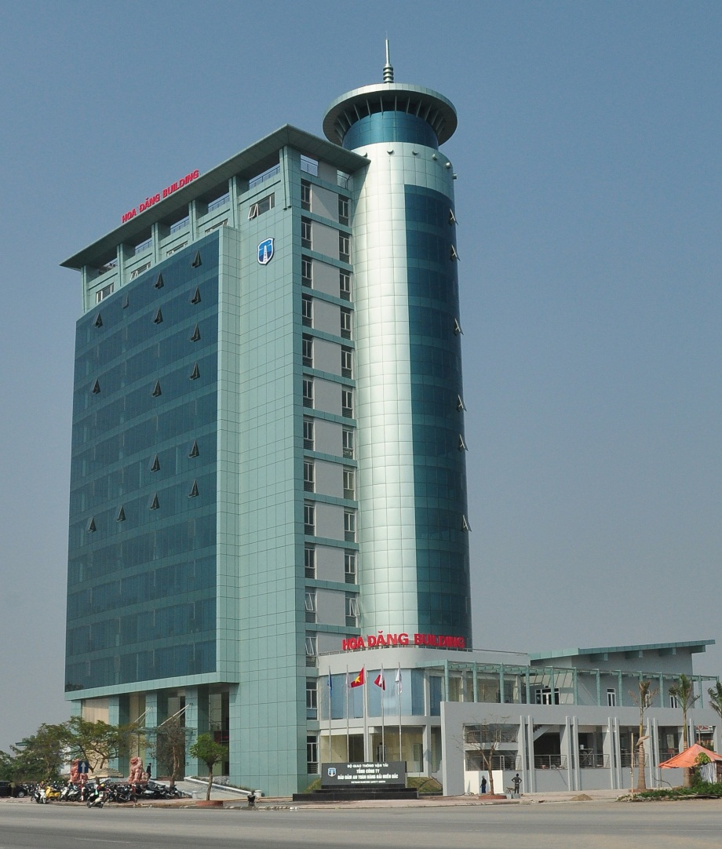
Self introduction
IHO – NIPPON FOUNDATION
ALUMNI SEMINAR
2007 – 2017:
The Director of Hydrographic Survey Division – North
2018 – Now:
The Head of Maritime Safety Department of Vietnam Maritime Safety - North
VMS-N

Slide 4
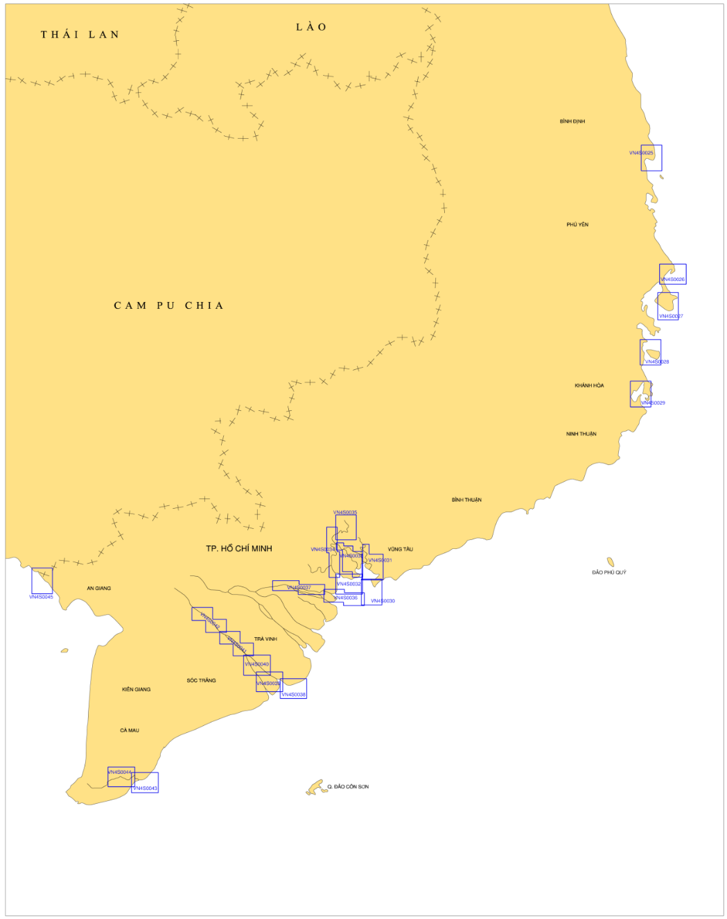
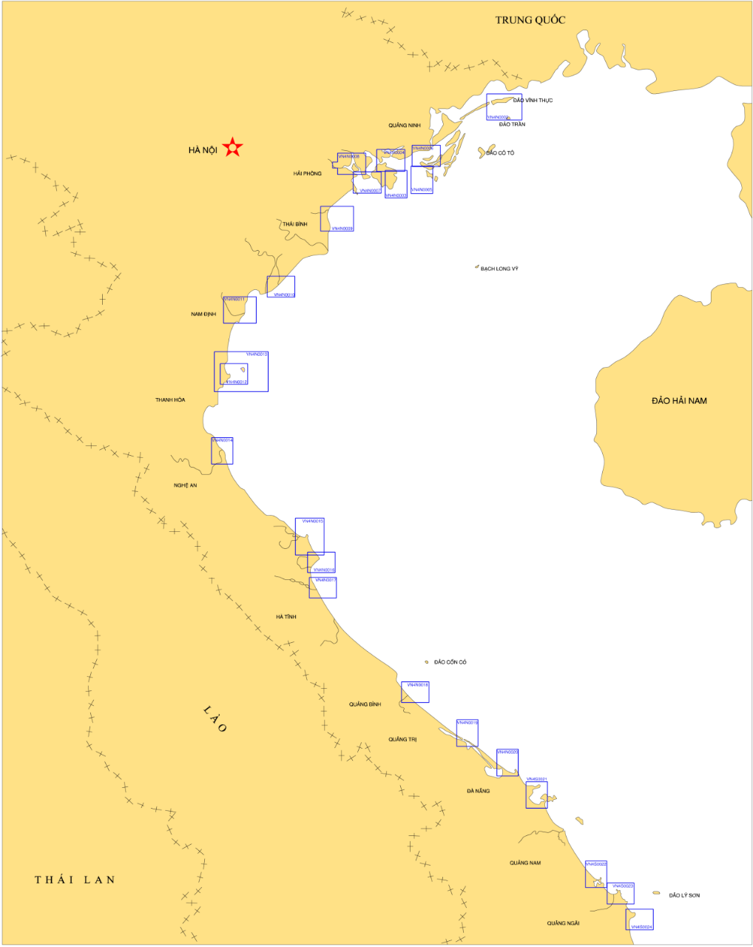
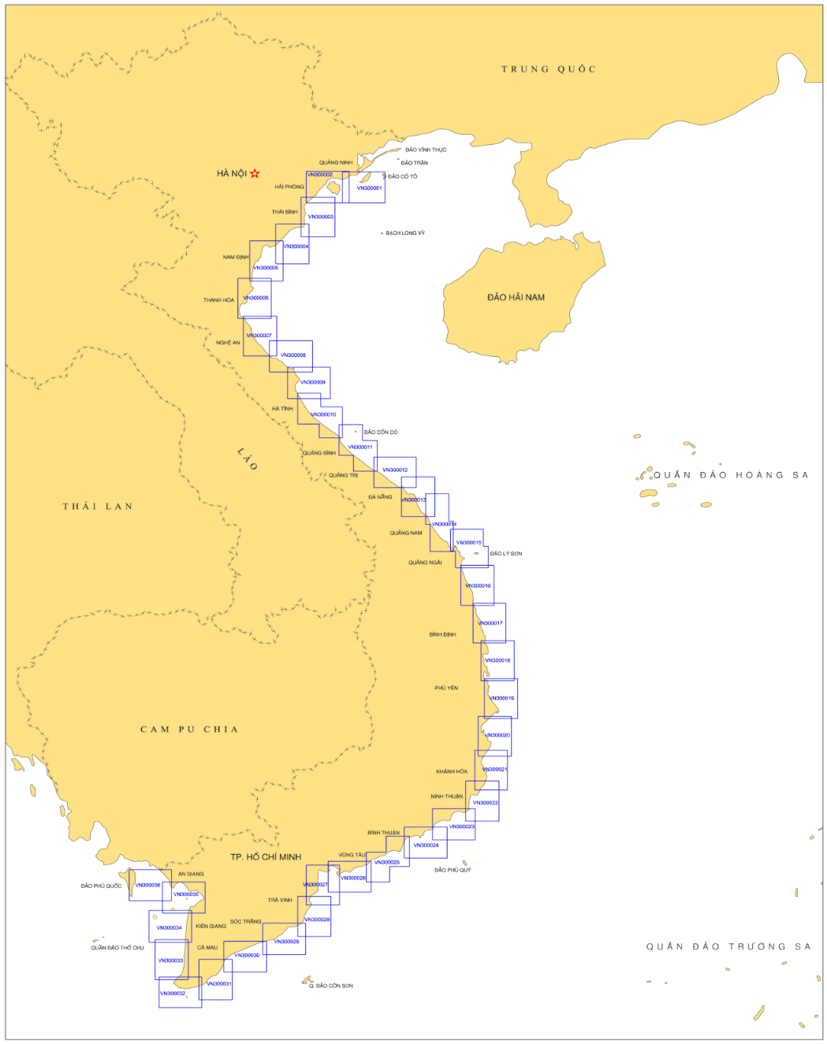
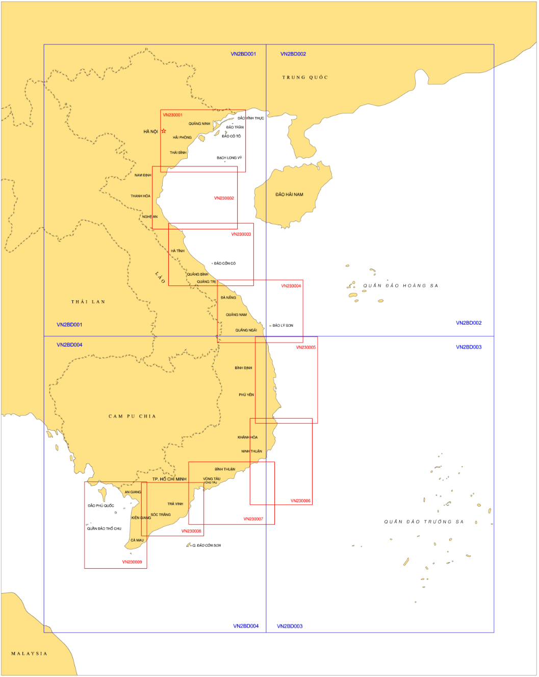
Key Projects:
IHO – NIPPON FOUNDATION
ALUMNI SEMINAR
1. Producing the Nautical Charts and ENC cells:
92 Paper Charts & 105 ENC cells have been issued;
46 nautical charts are under compilation.
Notes:
38 Paper charts & 38 ENC cells was declared by MOT;

Slide 5
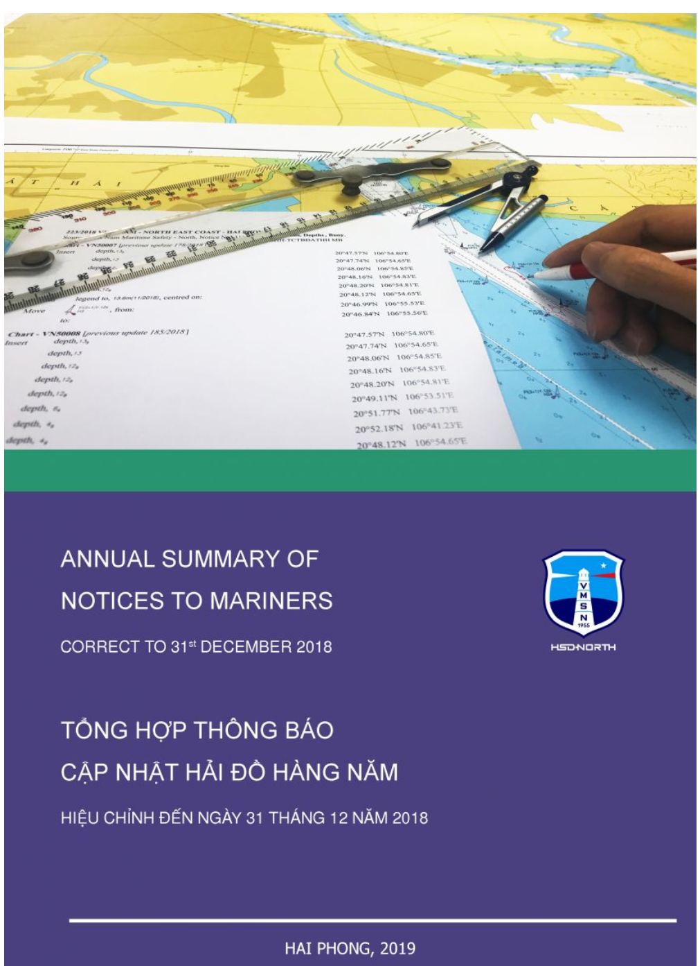
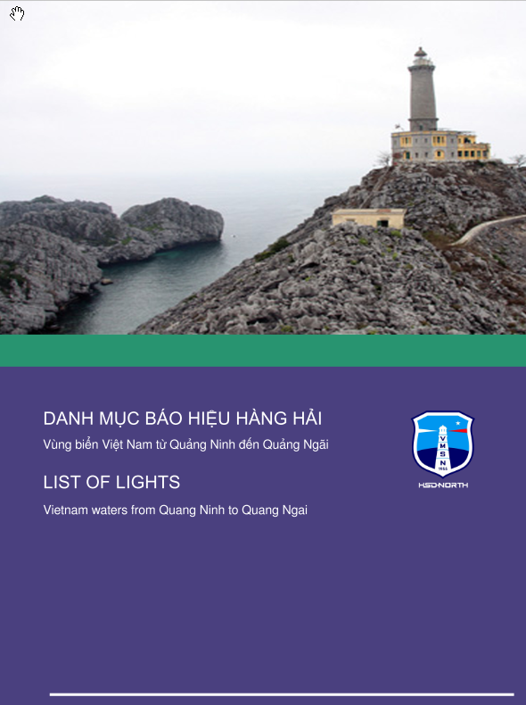
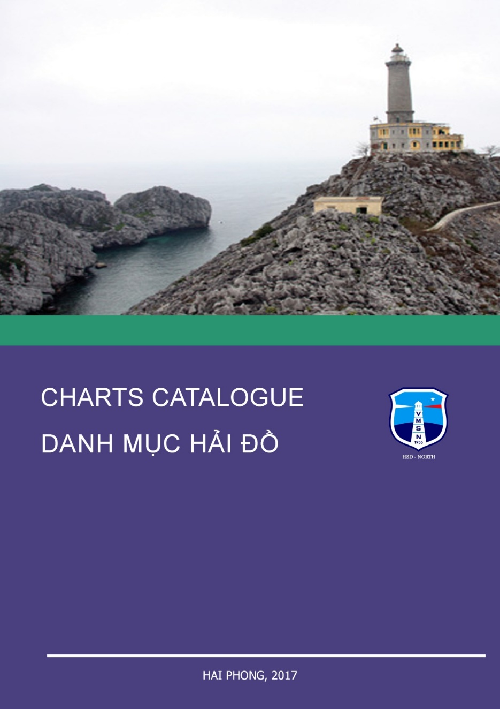
Key projects:
IHO – NIPPON FOUNDATION
ALUMNI SEMINAR
2. Maritime Publications:
Charts Catalogue;
Quarterly and Annual Summary of Notices To Mariners;
List of Lights;

Slide 6
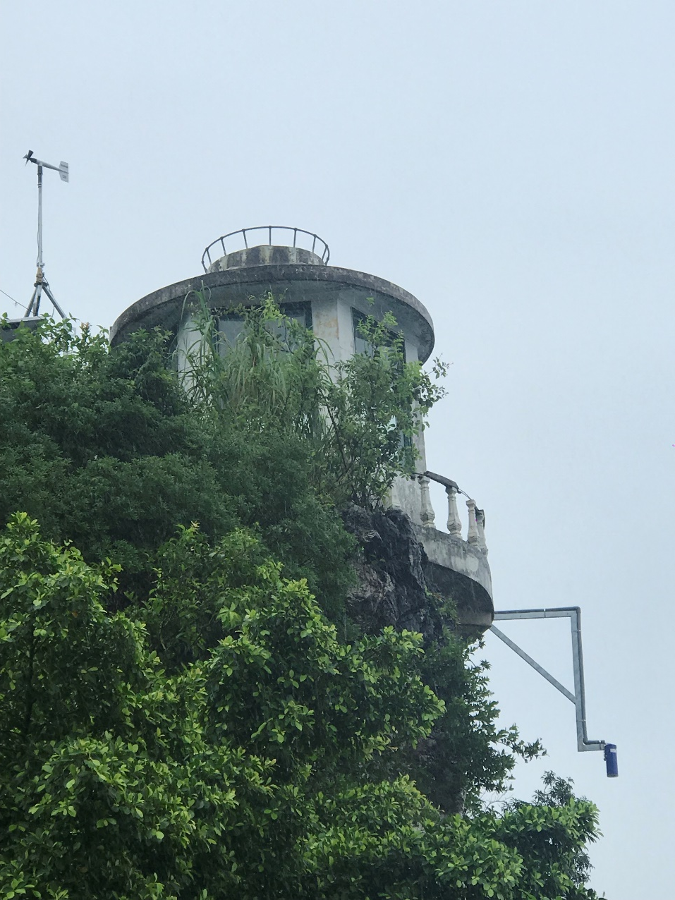
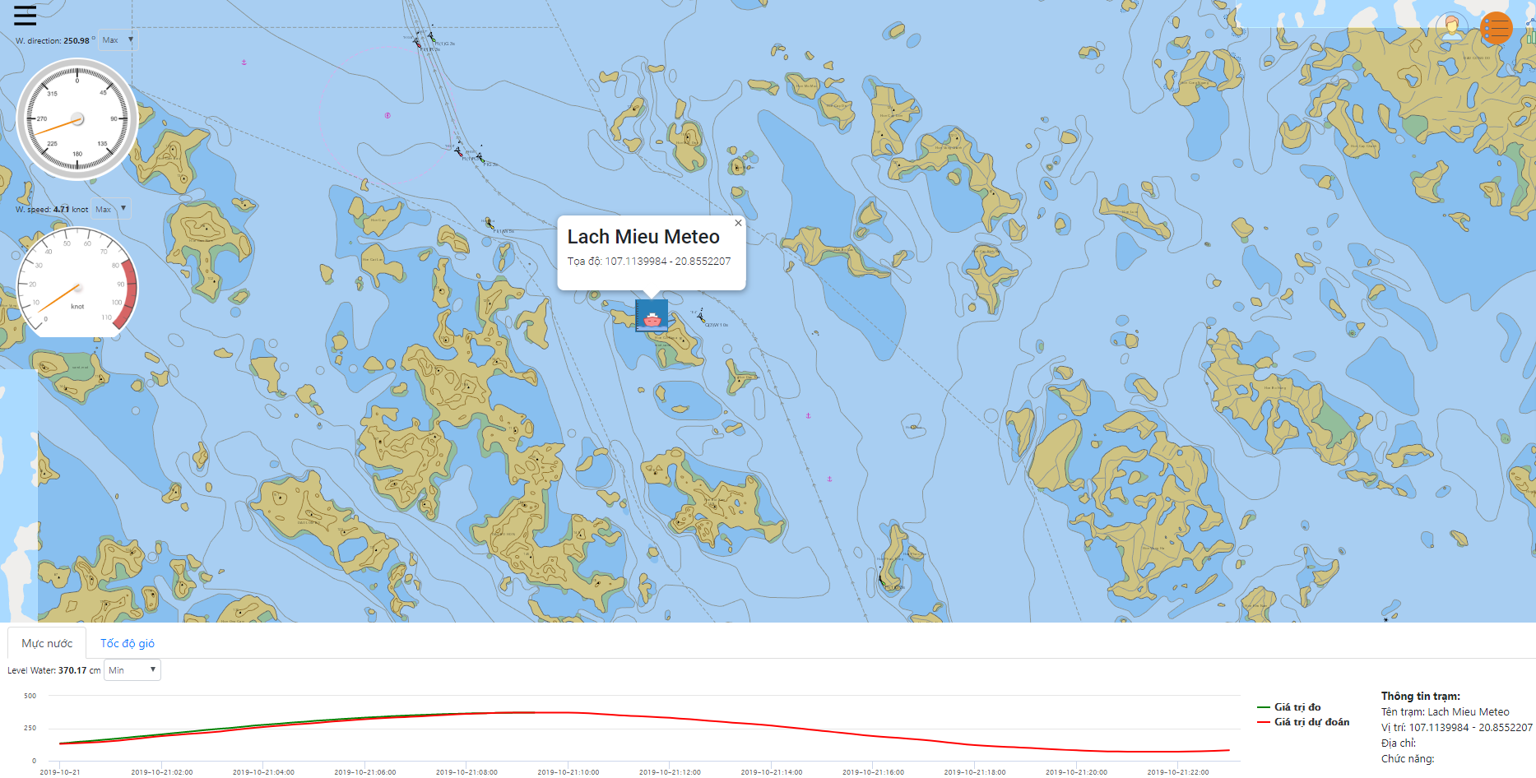
Key projects:
IHO – NIPPON FOUNDATION
ALUMNI SEMINAR
3. Installing the Automatic Tide gauges on the main ports

Slide 7
Key projects:
IHO – NIPPON FOUNDATION
ALUMNI SEMINAR
4. Building up Nautical Charts quality Control system and transferring the some IHO Standards into Vietnamese Standards.

Slide 8
Lessons learned from CHART Course:
IHO – NIPPON FOUNDATION
ALUMNI SEMINAR
1. Comprehensive knowledge about production, distribution of Nautical Charts;
2. Training people is the most important step of nautical charts production flow chart and it should be first;
3. Sharing the information and data could increase the safe navigation and decrease the transportation expense;
4. The role of community and networking in safety of navigation,…

Slide 9
Suggestion for the future:
IHO – NIPPON FOUNDATION
ALUMNI SEMINAR
1. Keep maintaining the Nautical Chart training course for nations are not IHO members, newly IHO members;
2. Nippon Foundation should fund for CAT A cartographic training course and hydrographic survey, specially the CAT A, B hydrographic courses in Japan or other countries;
3. Selecting right person of right organization for training course;

Slide 10
HSD - NORTH
THANKS FOR LISTENING!

